Slide 1
Demo Project
RXBOOKTRACKER

Slide 2
Objective
Demo project
Demo project name is RxBookTracker
Understand the structure of the application
Sample Hello World
install RxJS using npm.

Slide 3
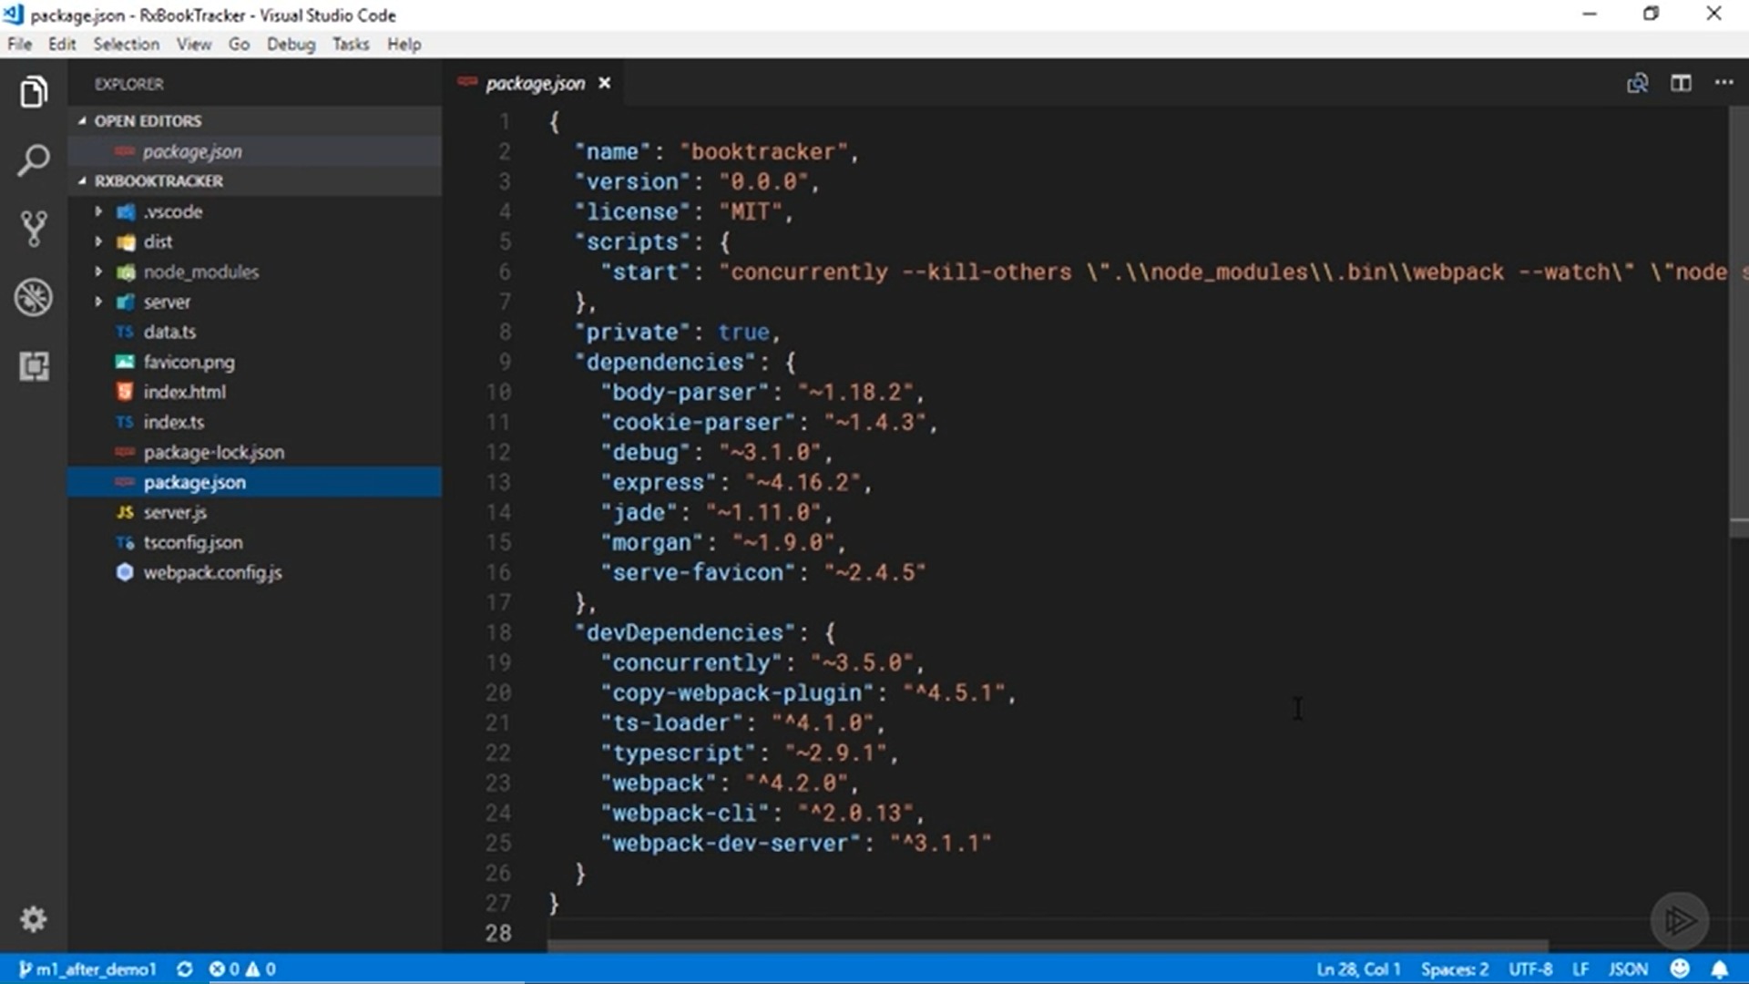

Slide 4
Start with a shell of an application that includes some server code and an API that will let us work with Book and Reader objects.
That will let us experiment with some slightly more realistic scenarios than just working with strings and numbers all the time.

Slide 5
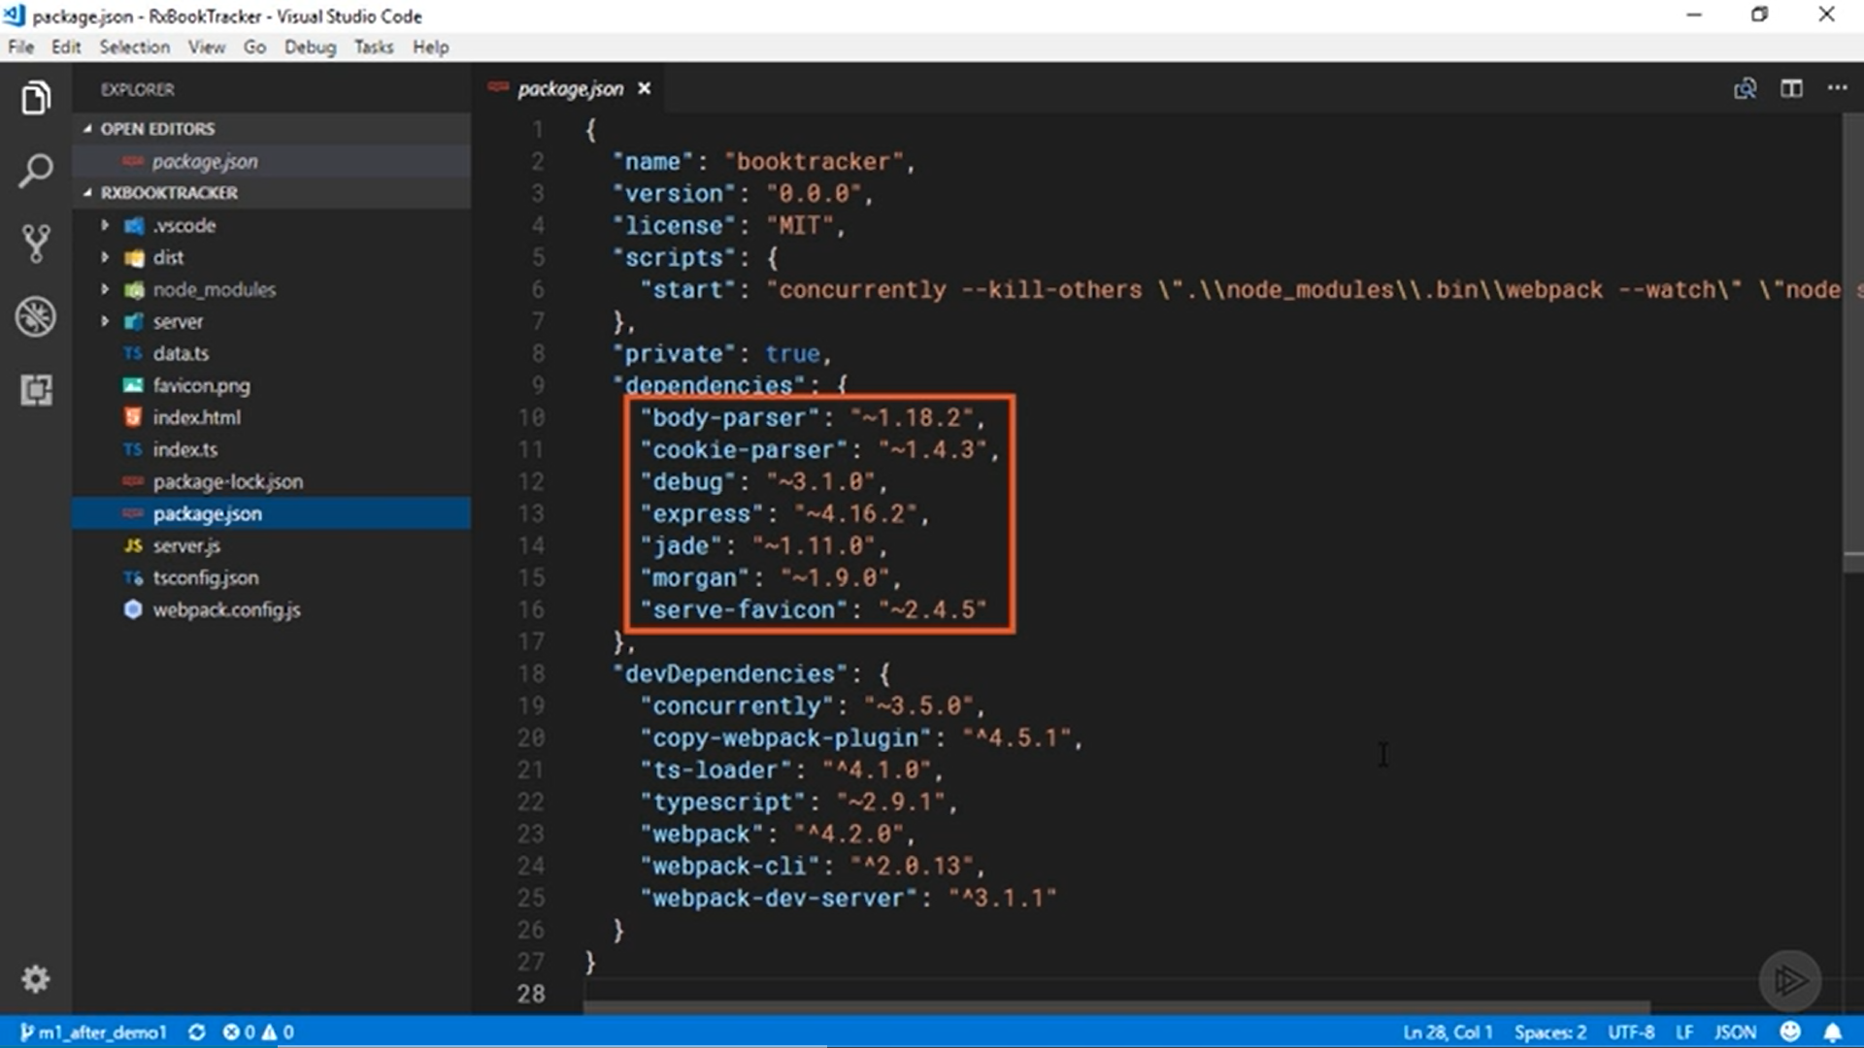

Slide 6
Open package. json file see the npm packages which are already available
Intitally we did not installed RsJS.
All of the packages you see here in the dependencies section are used by the Node server application which is present in the application.
It's a very basic Node and Express app that exposes a few REST endpoints and will serve the client code to the browser.

Slide 7
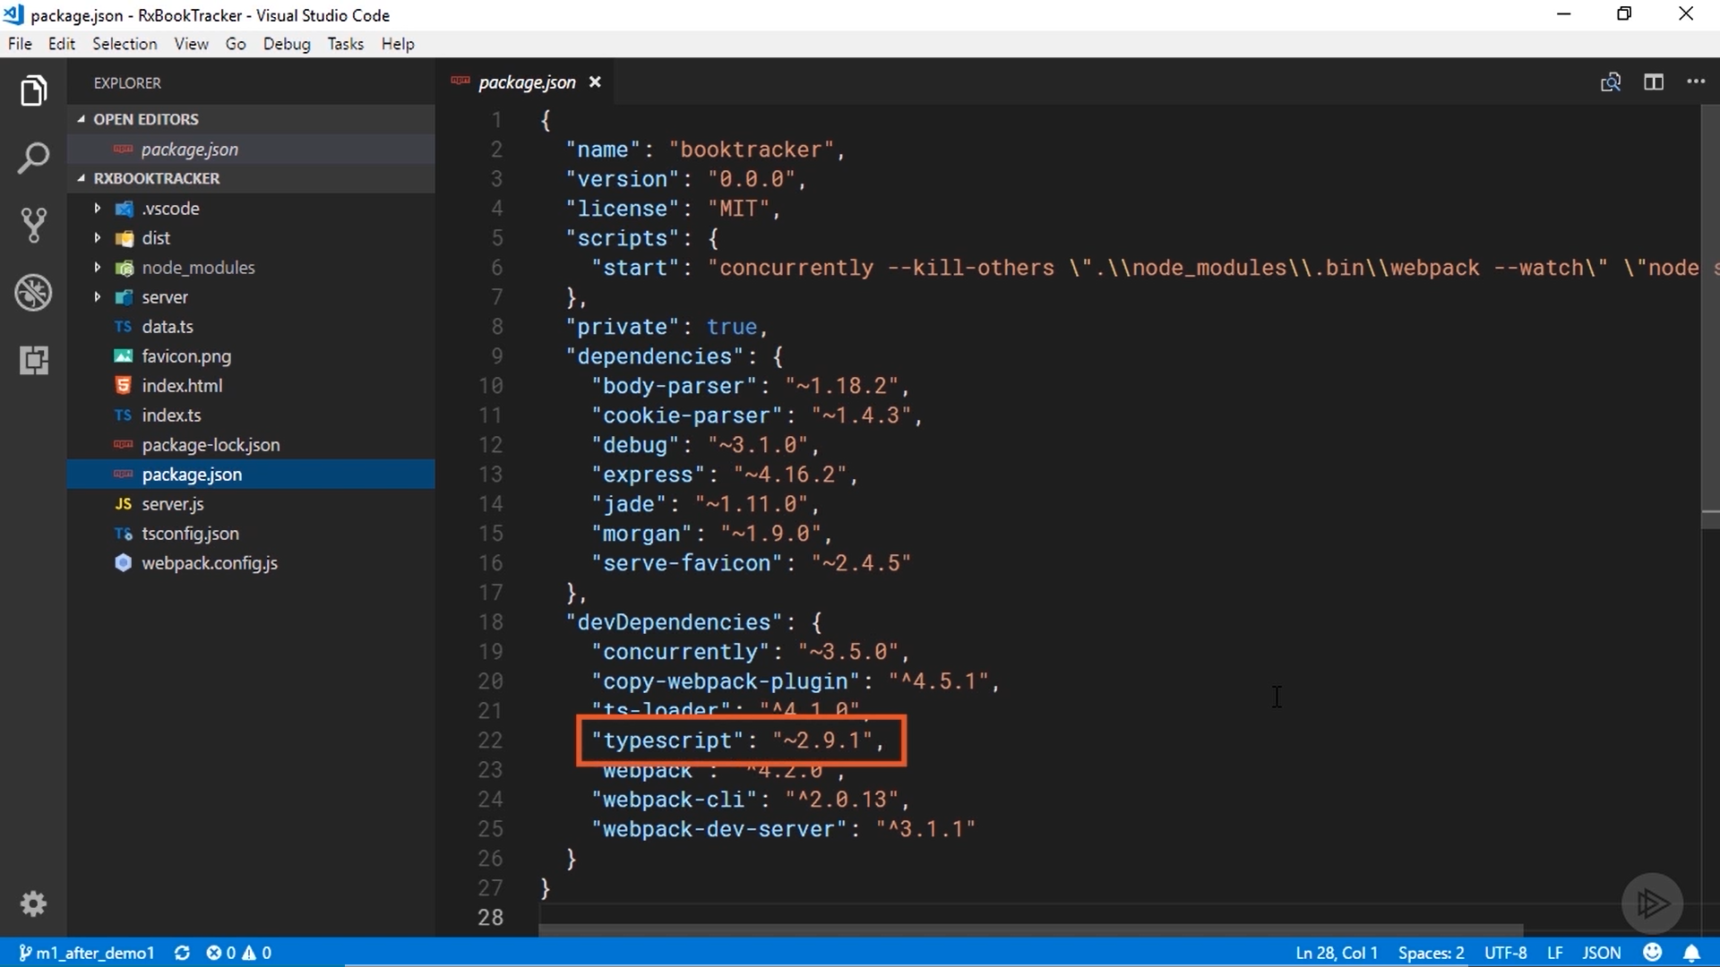

Slide 8
In the devDependencies section, you can see that I'll be using the TypeScript compiler.
We will write all of the code in the course using the ES2015 version of Java Script, and use the TypeScript compiler to transpile that to ES5 that will run reliably in the browser.
Note that RxJS is written in TypeScript, You don't have to know typescript to use it, at least being familiar with TypeScript can be helpful as you browse the documentation and source code.

Slide 9
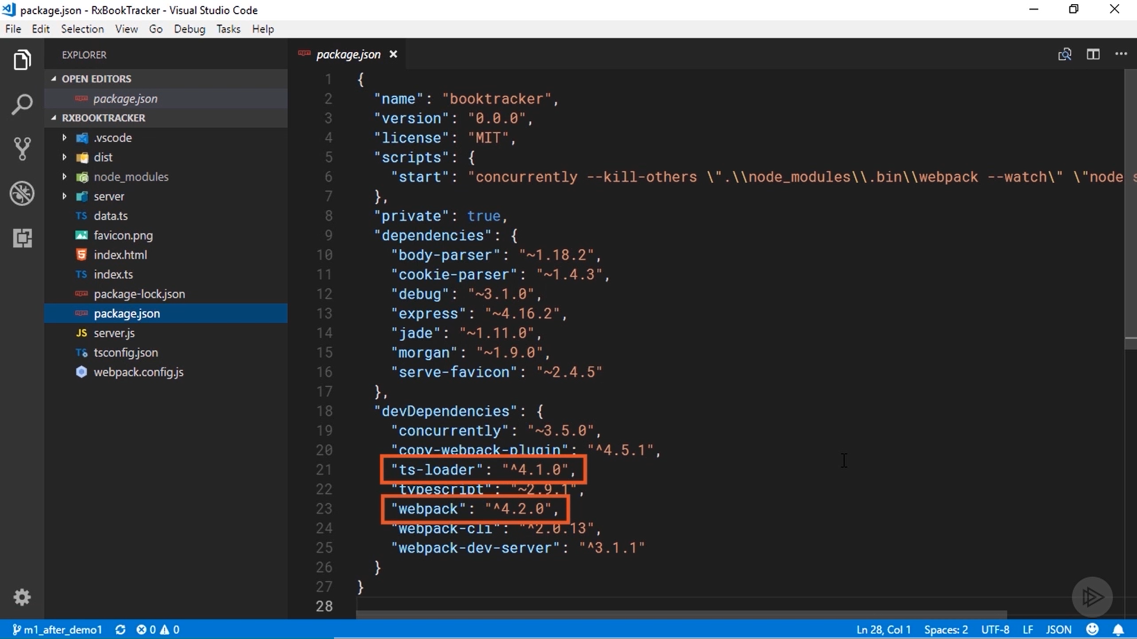

Slide 10
We will use Webpack and its TypeScript loader to transpile and bundle the code.

Slide 11
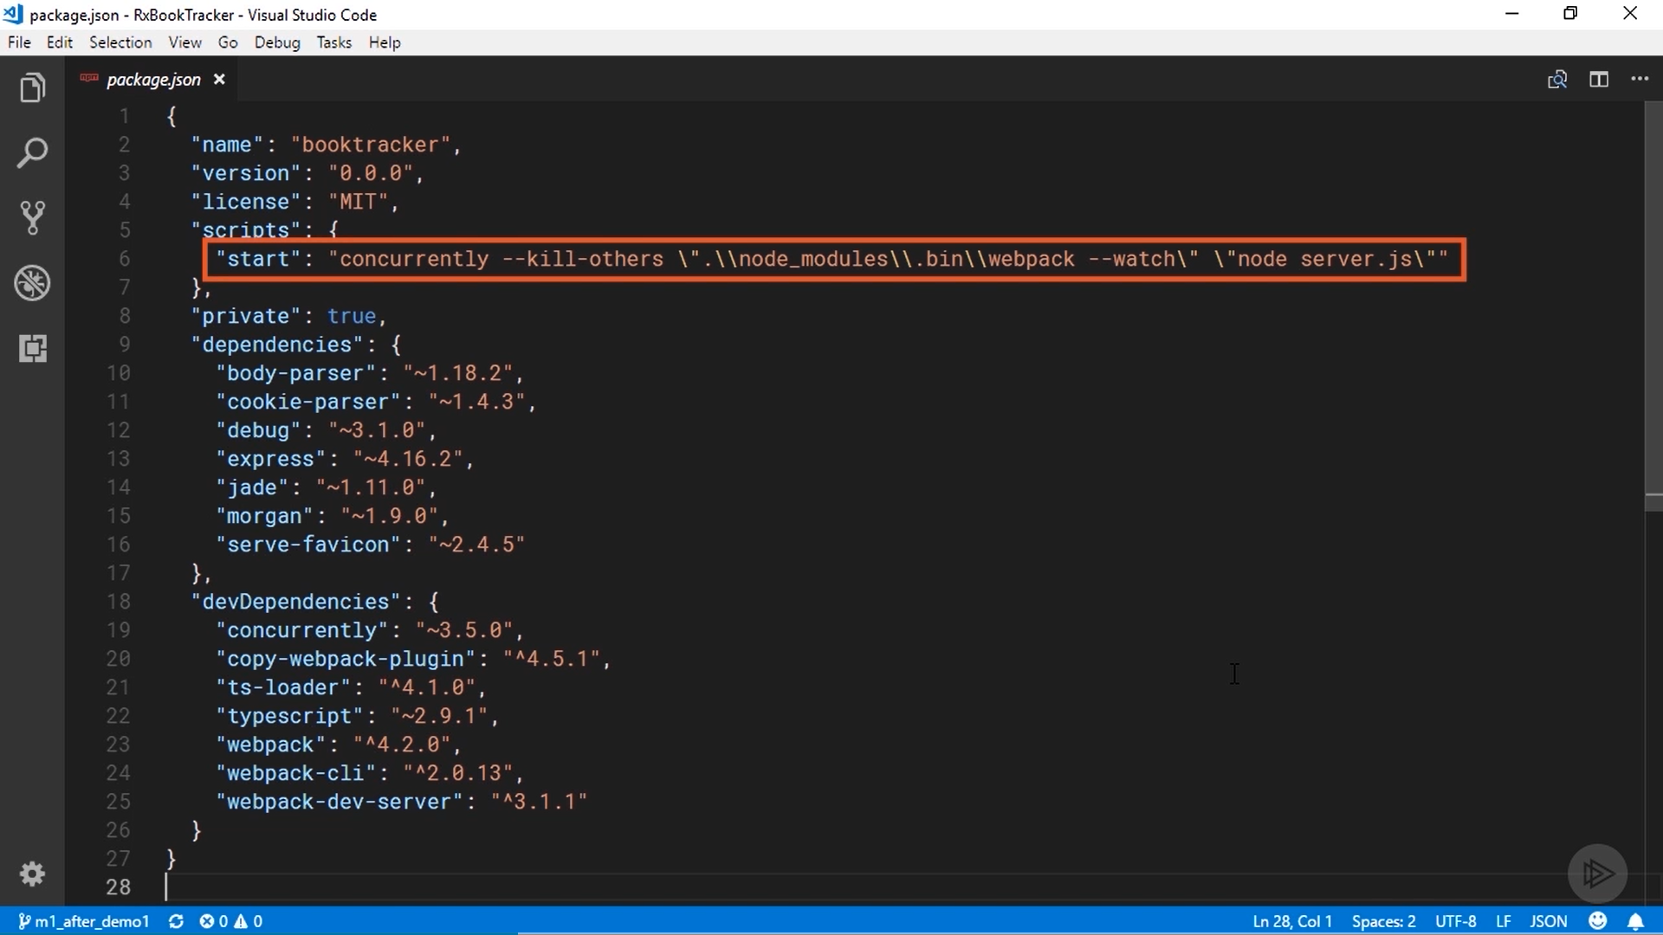

Slide 12
We will kick off that process and start the web server using the npm start script
It is defined at the top of the file.
We are using the concurrently package to effectively execute two commands inside the script.
The first starts webpack in watch mode, which will automatically recompile and re-bundle the code as soon as I change it.
The second command starts the node web server .

Slide 13
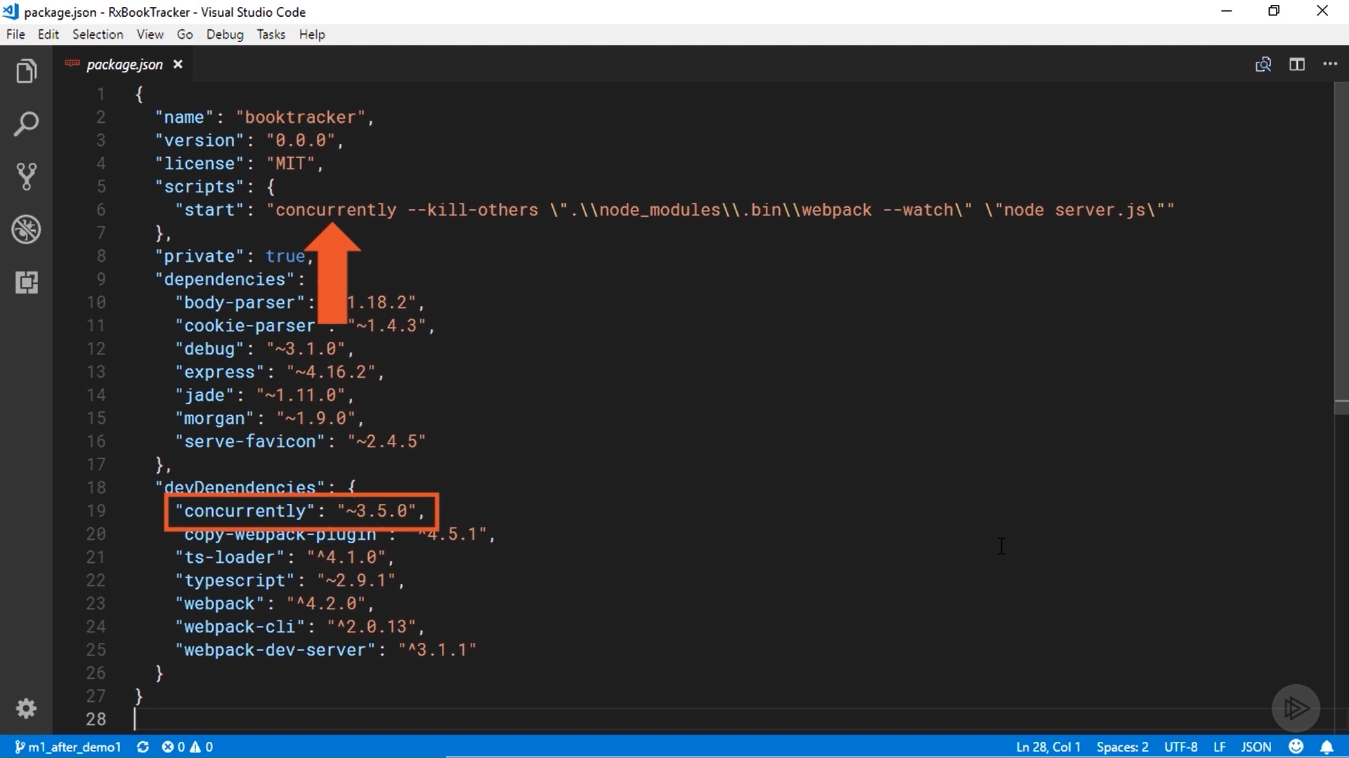

Slide 14
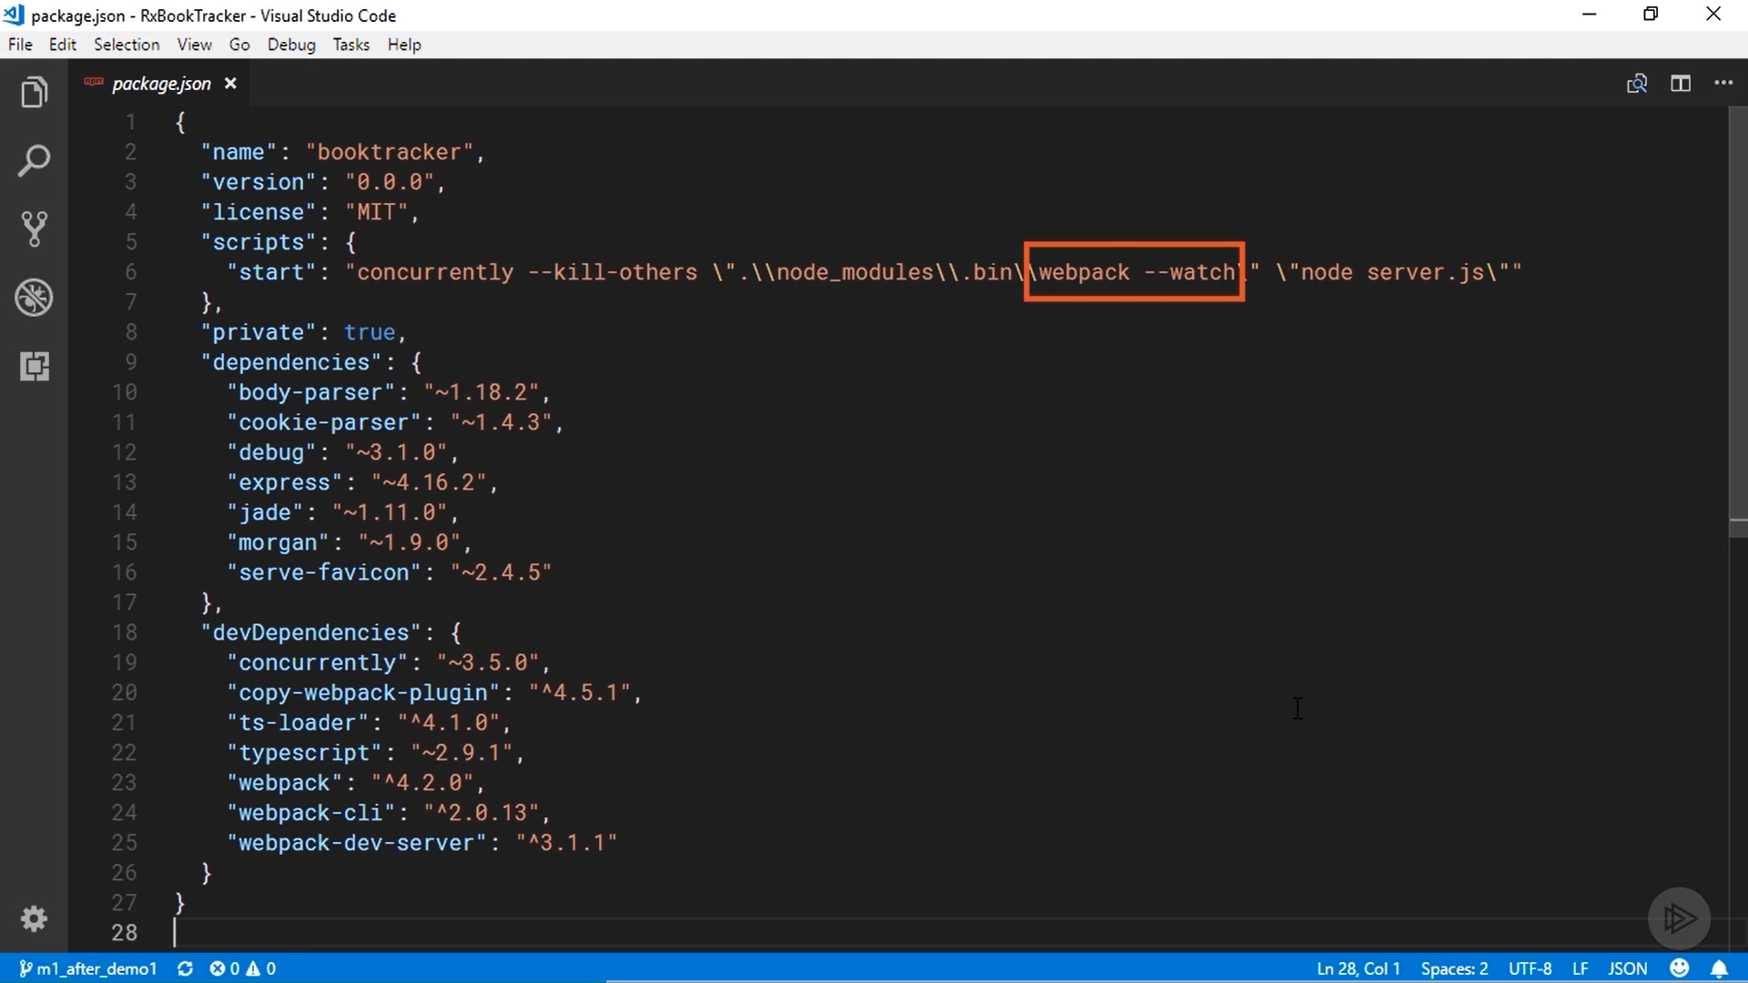

Slide 15
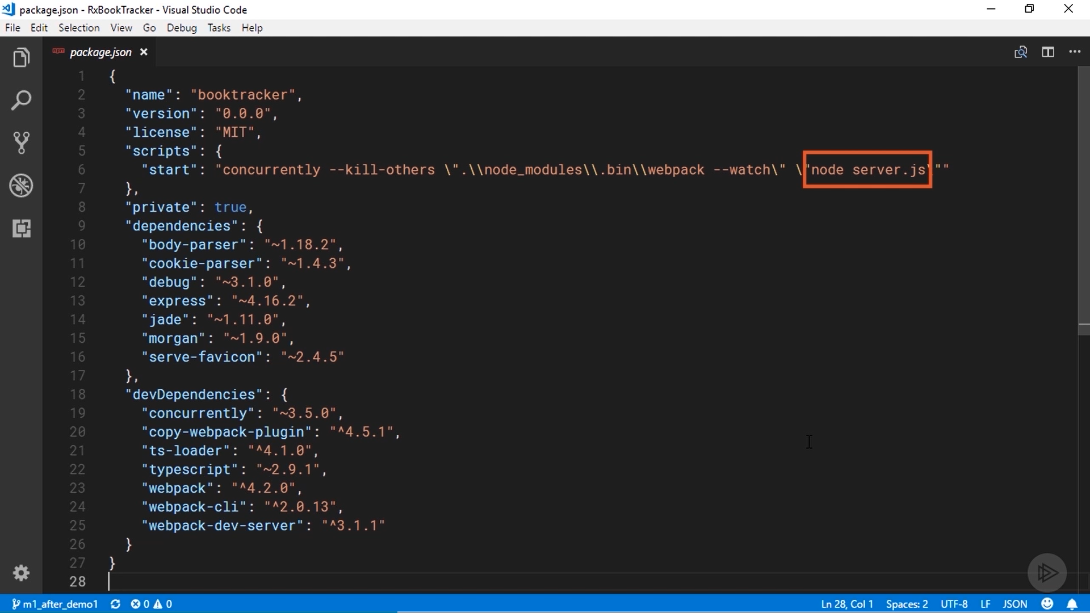

Slide 16
Let’s look inside the webpack. config. js file.
This contains all of the configuration information about how I want Webpack to compile and bundle the code.
The entry point for the app is the file named index. ts, which you can also see to the left in the project explorer.
That's where we will write most of the code.
These middle sections just configure the ts-loader module to compile the TypeScript files.

Slide 17
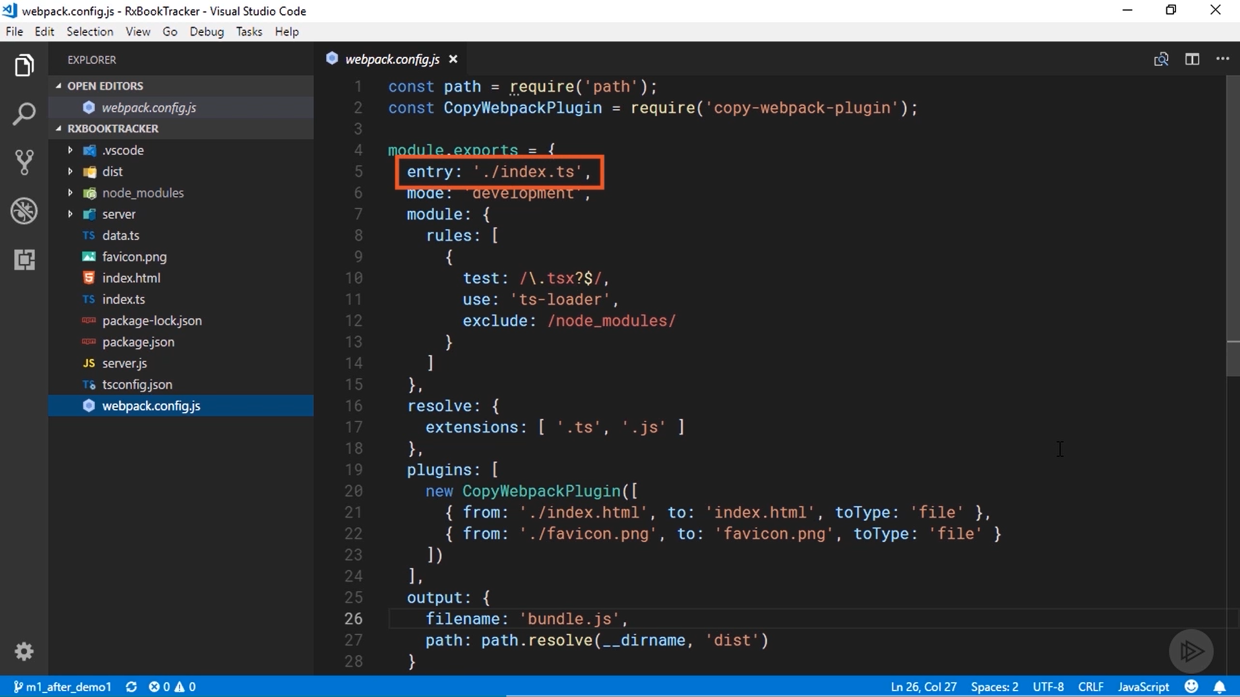

Slide 18


Slide 19
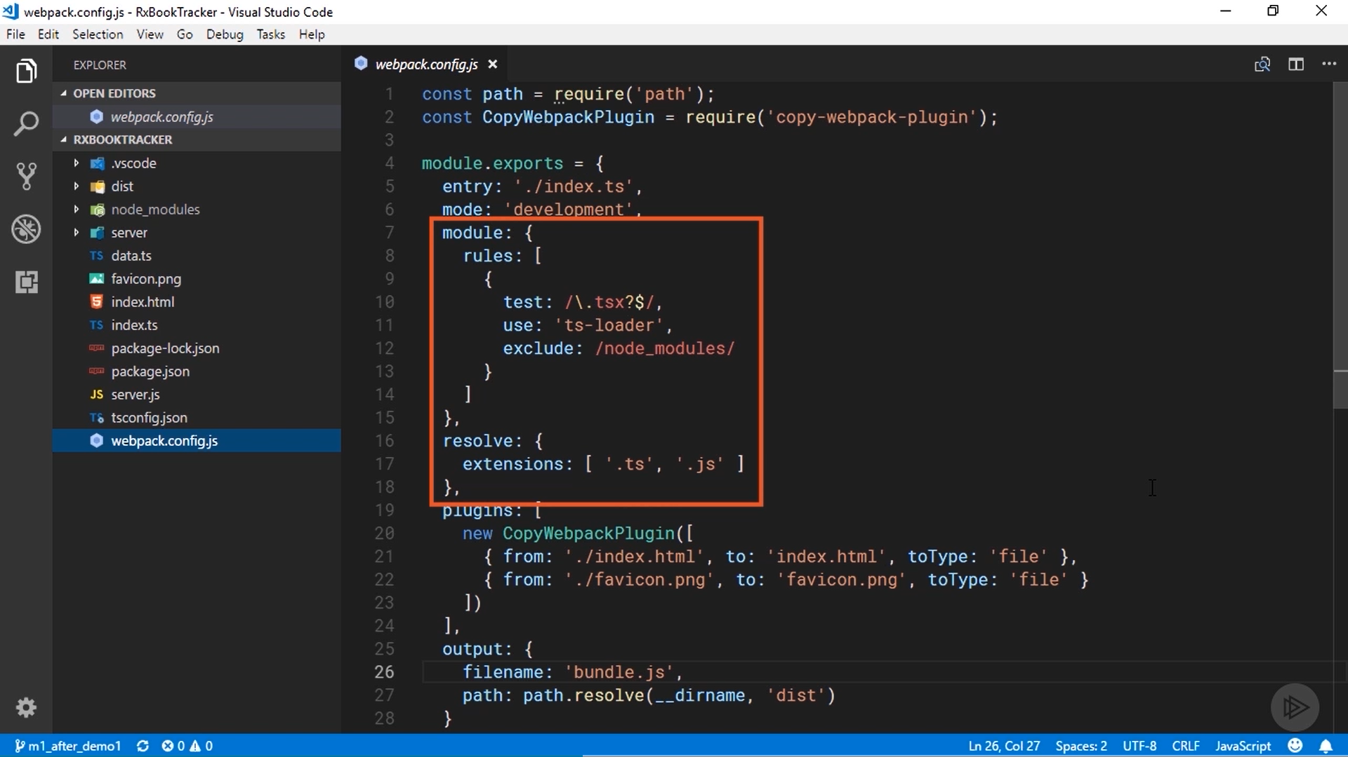

Slide 20
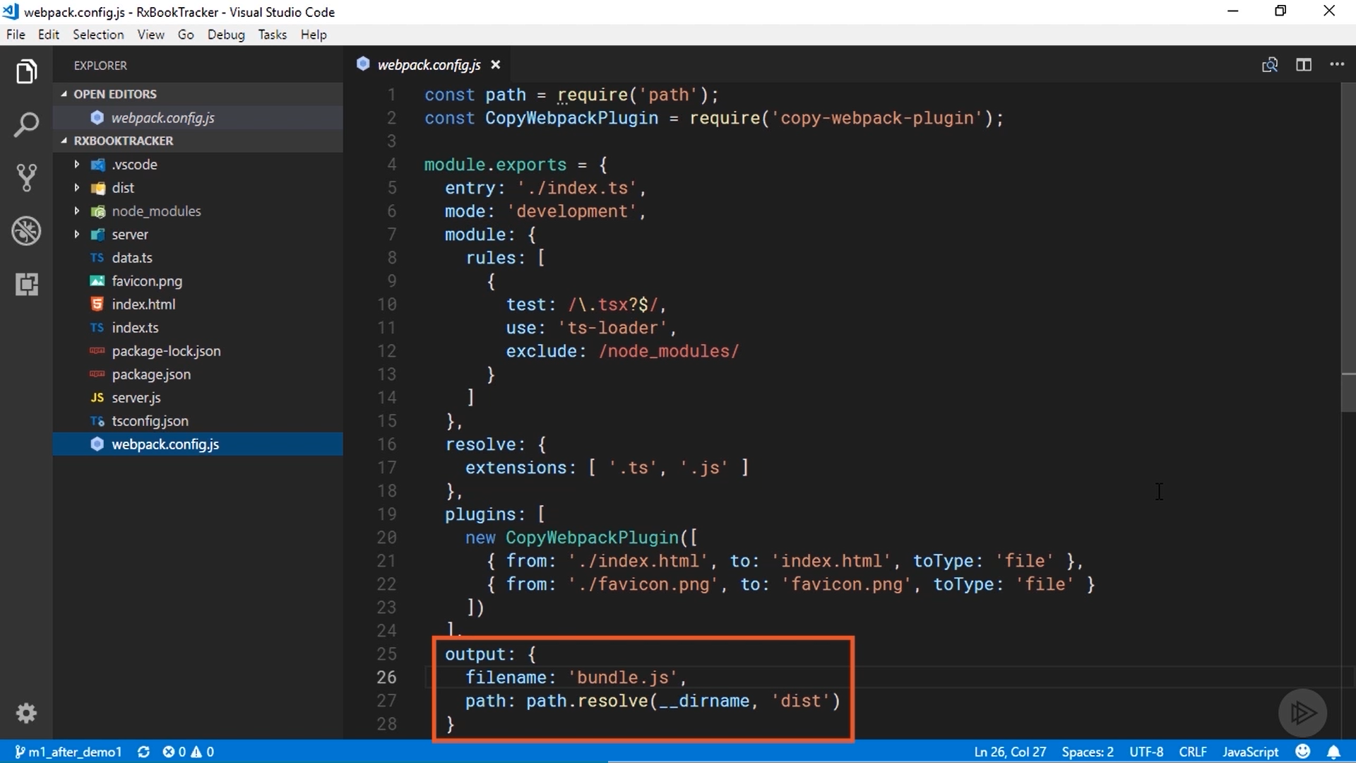

Slide 21
The output section at the bottom specifies that all of the compiled output should be bundled into a file named bundle. js and put inside the dist folder in the project.
We are using a Webpack plugin to copy the index. html file and the favicon into the dist folder.
The index. html file sits at the root of the project and the only thing inside it right now is a reference to the bundle. js file that will be output by Webpack.

Slide 22
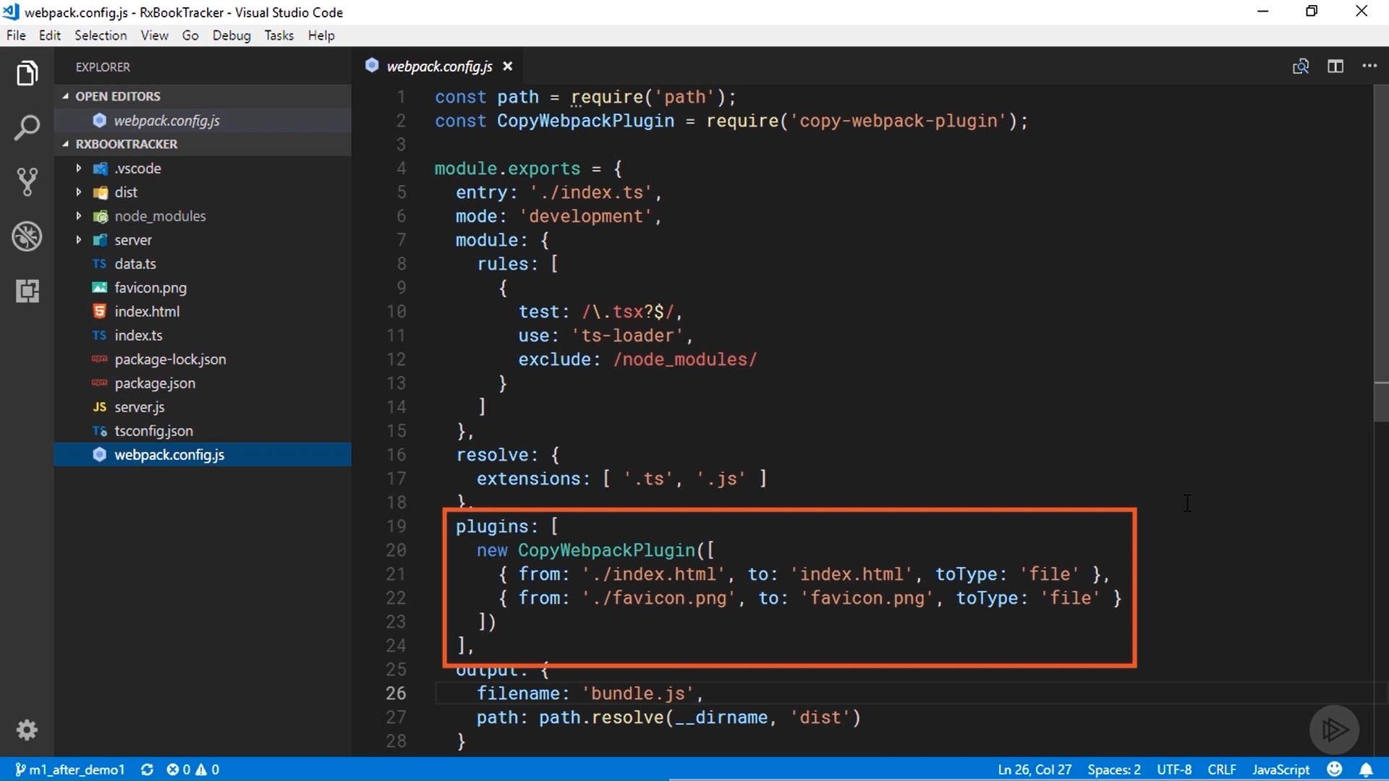

Slide 23
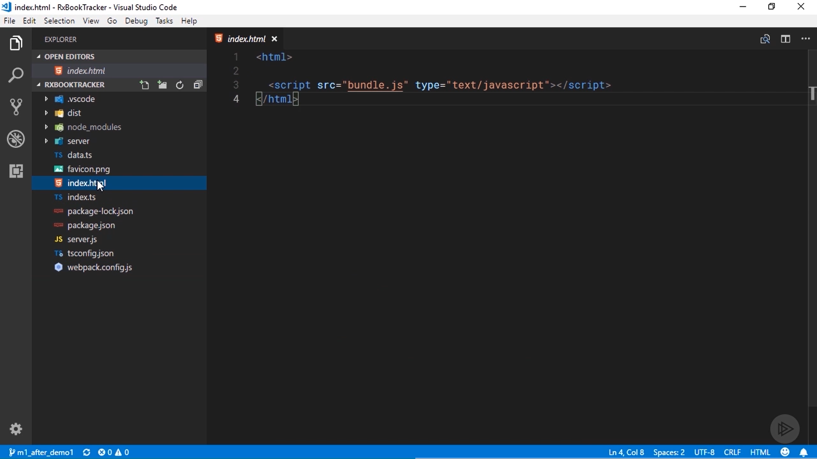

Slide 24
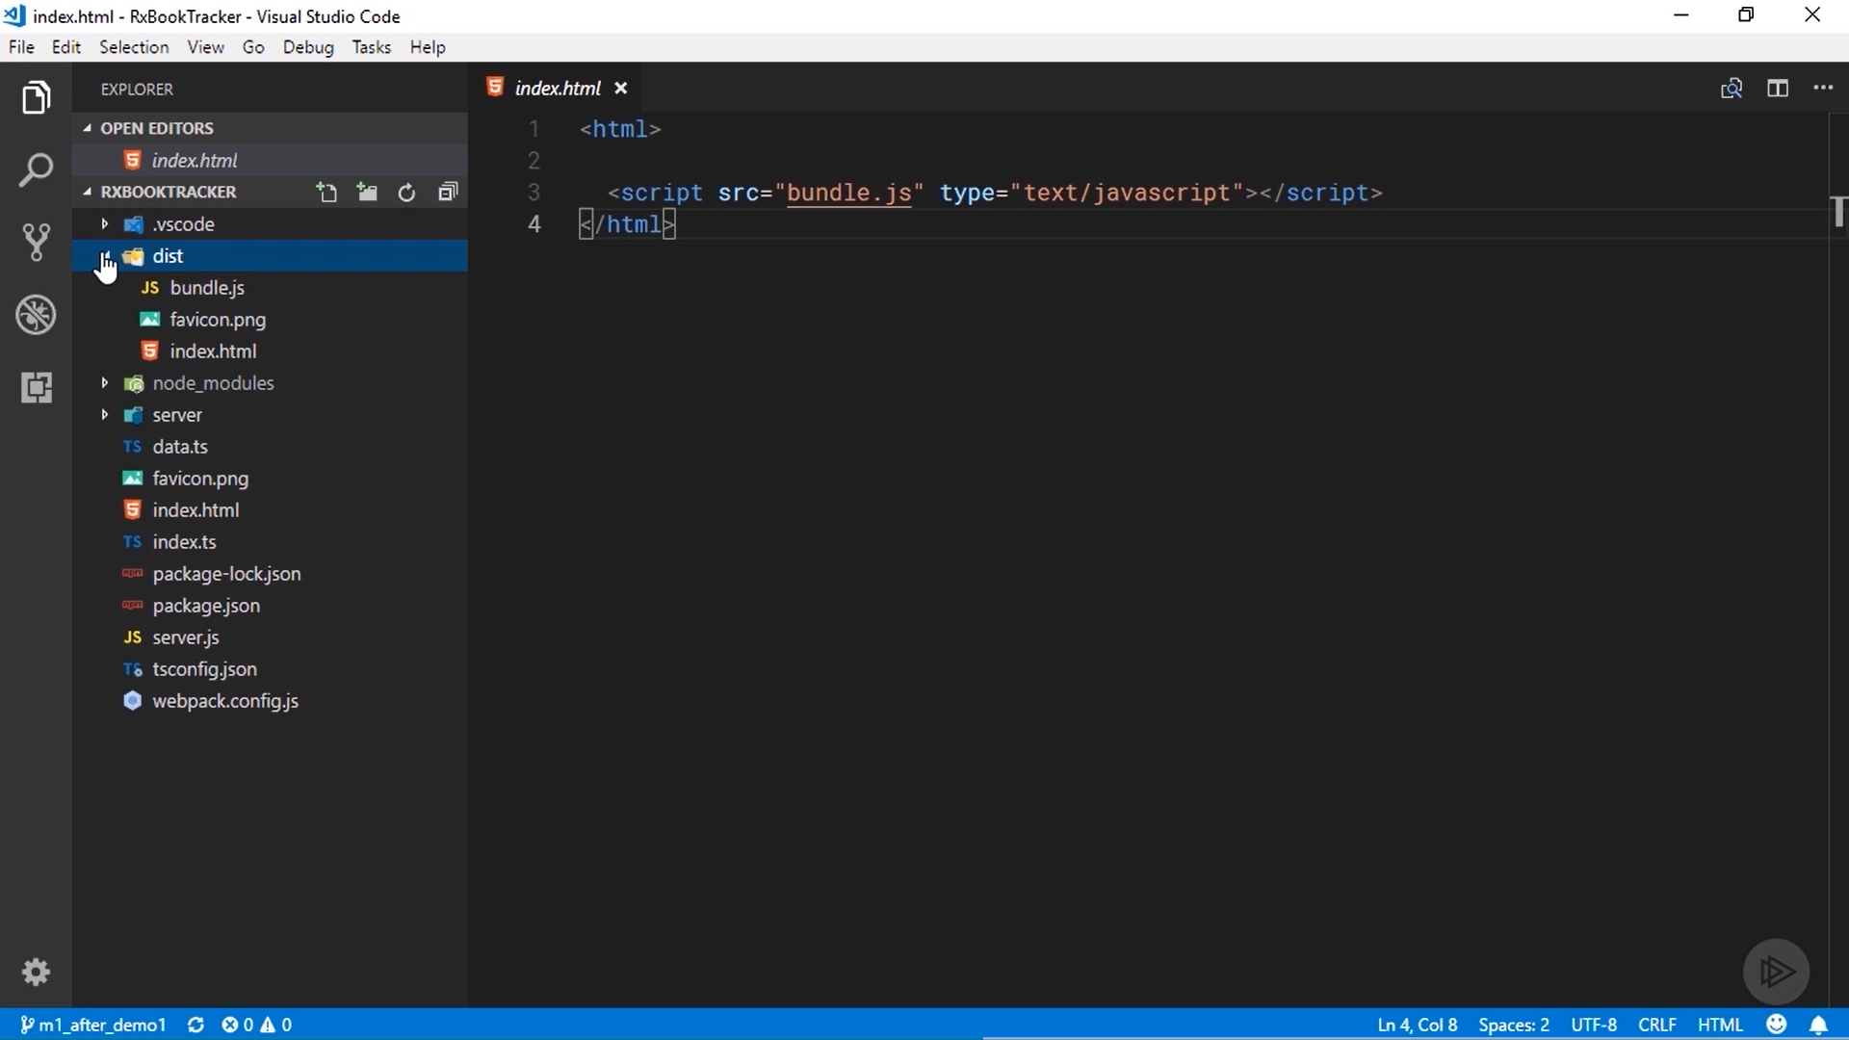

Slide 25
Expand the dist folder, and you can see that it has the index file, the bundled JavaScript file, and the favicon.
The web server will serve the files to the browser from this location.

Slide 26
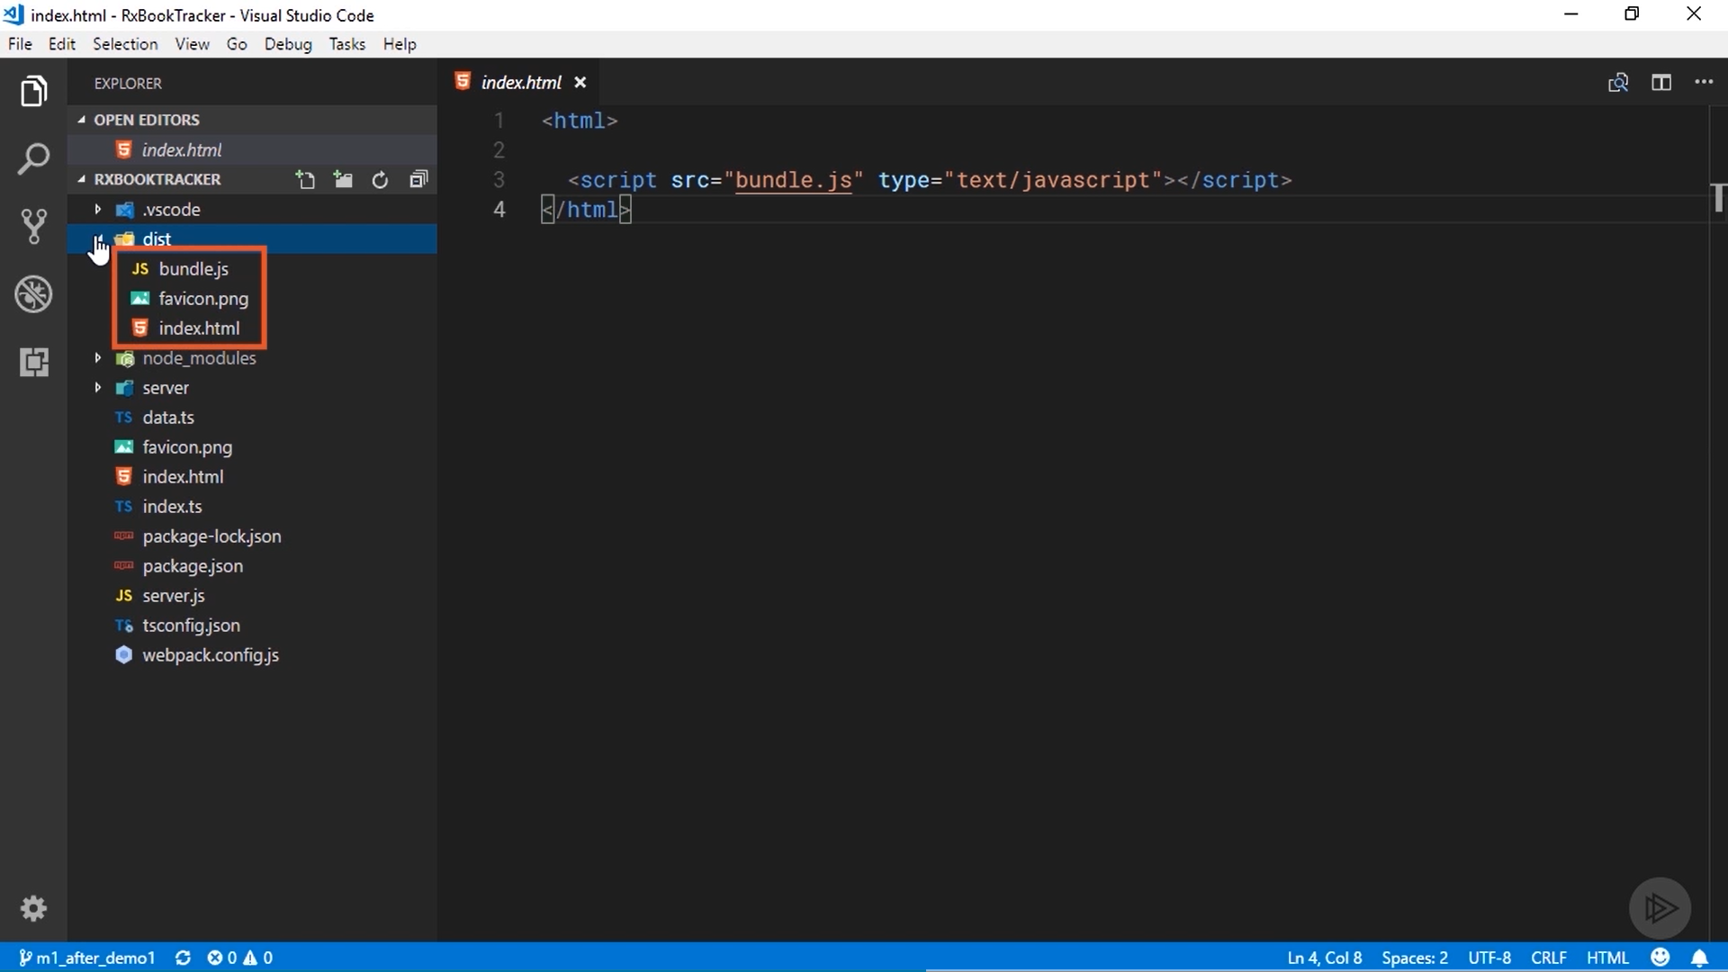

Slide 27
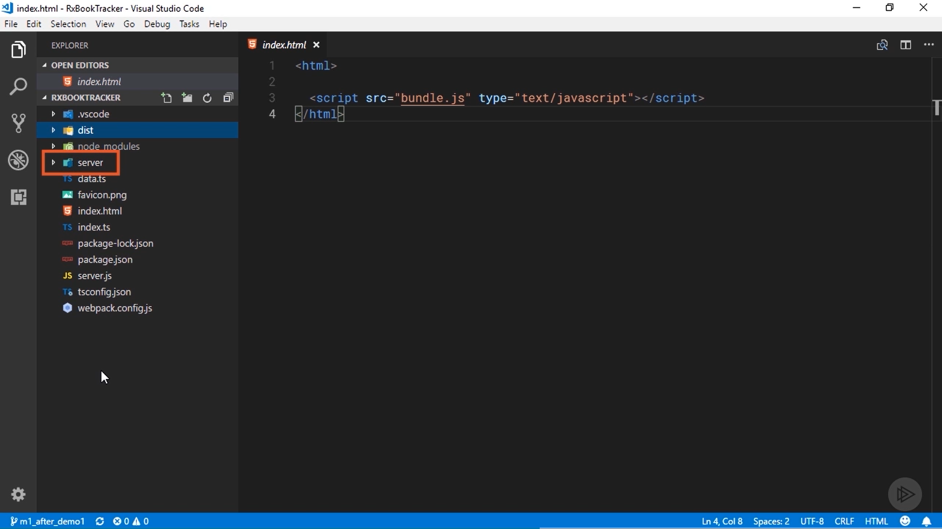

Slide 28
There are just a couple of other files. All of the code for the server is inside this server folder.
We are not going to cover any of it in the course, but feel free to download the code and poke around in there if you like.
The data. tst file just contains some sample book and reader data for us to experiment with. We will retrieve the same data with an HTTP request to the web server.

Slide 29
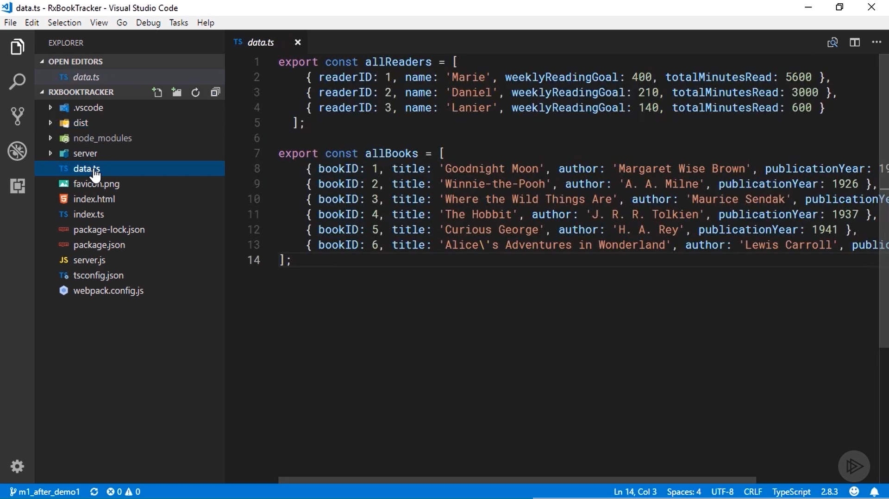

Slide 30
The books are just a collection of popular children's books.
Each object has an ID, the title, author, and the year the book was published.
The array of readers at the top includes the name of each reader and their weekly reading goal in minutes, along with how many minutes they've read so far.
These are very simple objects, we will use them to demonstrate all of the important topics.

Slide 31
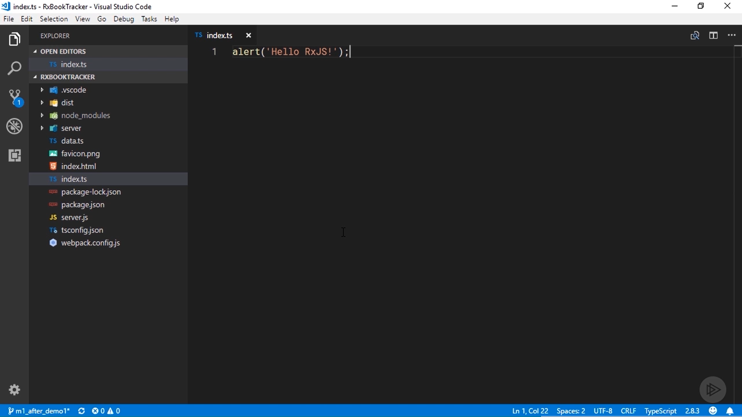

Slide 32
index. ts file is the starting point for the app.
You can see that it's currently completely empty.
add a simple alert statement see if everything is working as expected.
We have got npm script that will start Webpack and the web server.
Use the terminal built in to Visual Studio Code to run it.
If you're not using VS Code, you can do this from a standard command prompt or terminal.

Slide 33
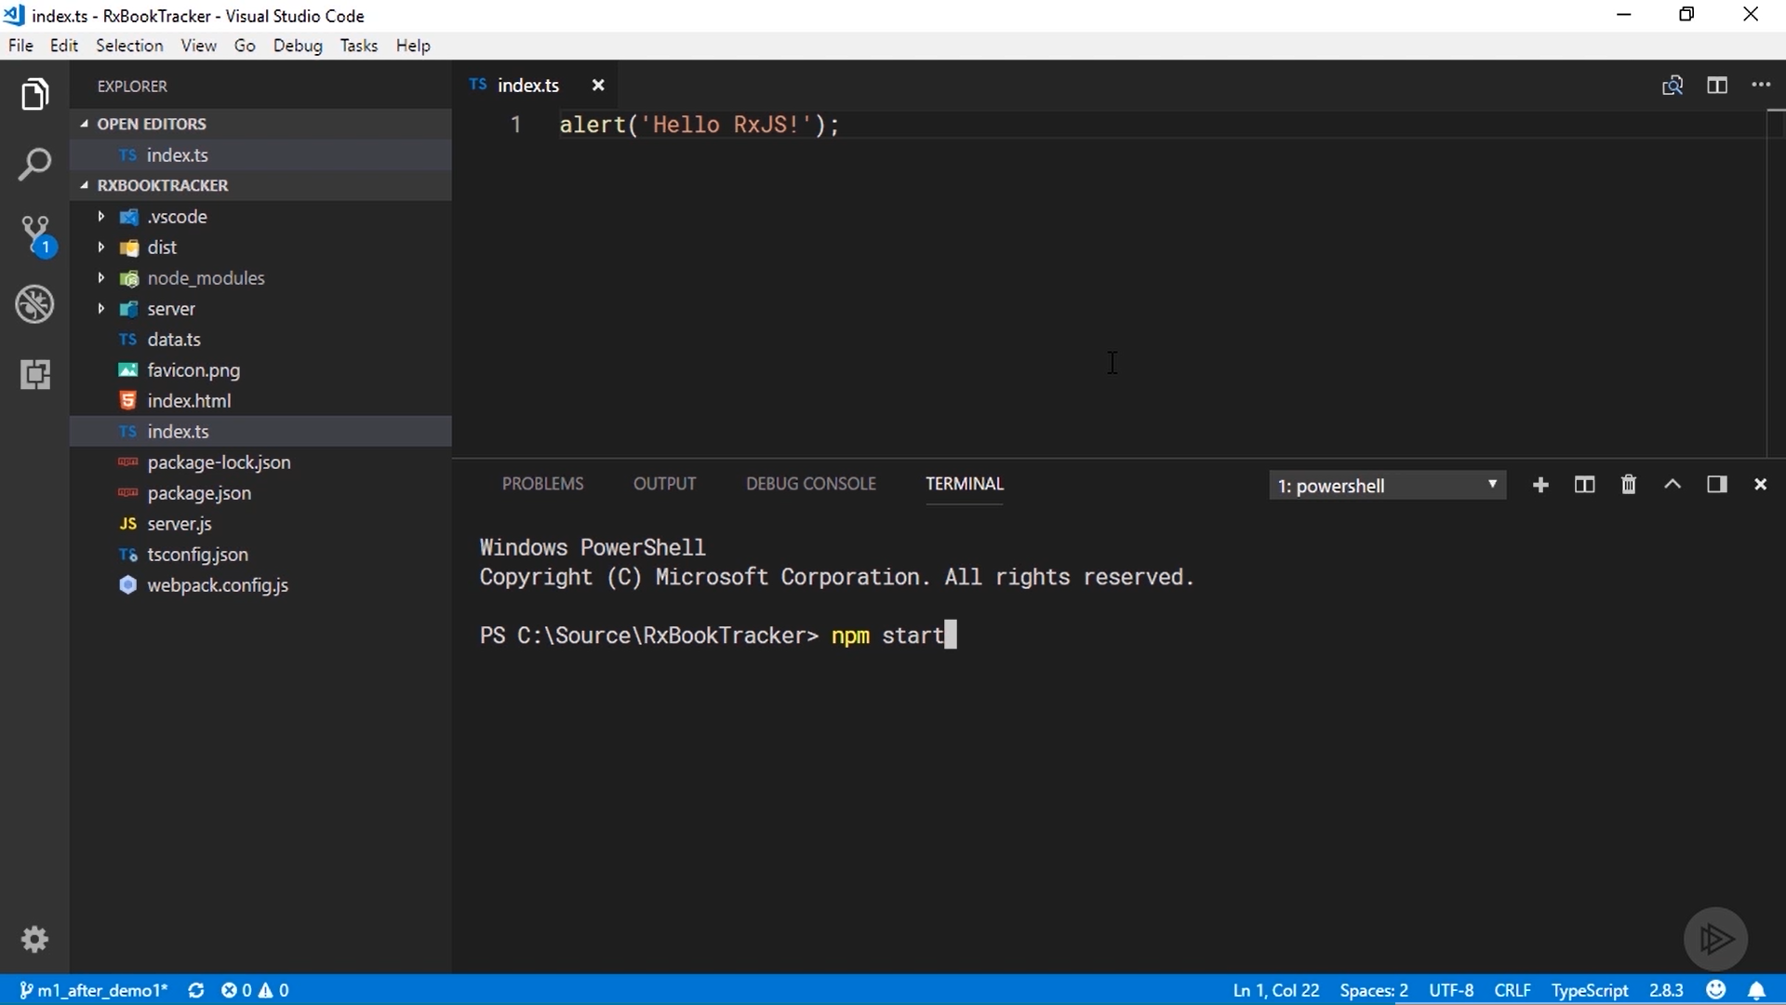

Slide 34
From the root directory in the project, type npm start to run the start script I defined in the package. json file.
You can see from the output that the web server is now listening on port 3000, and the list of assets output by Webpack are displayed here at the bottom.

Slide 35
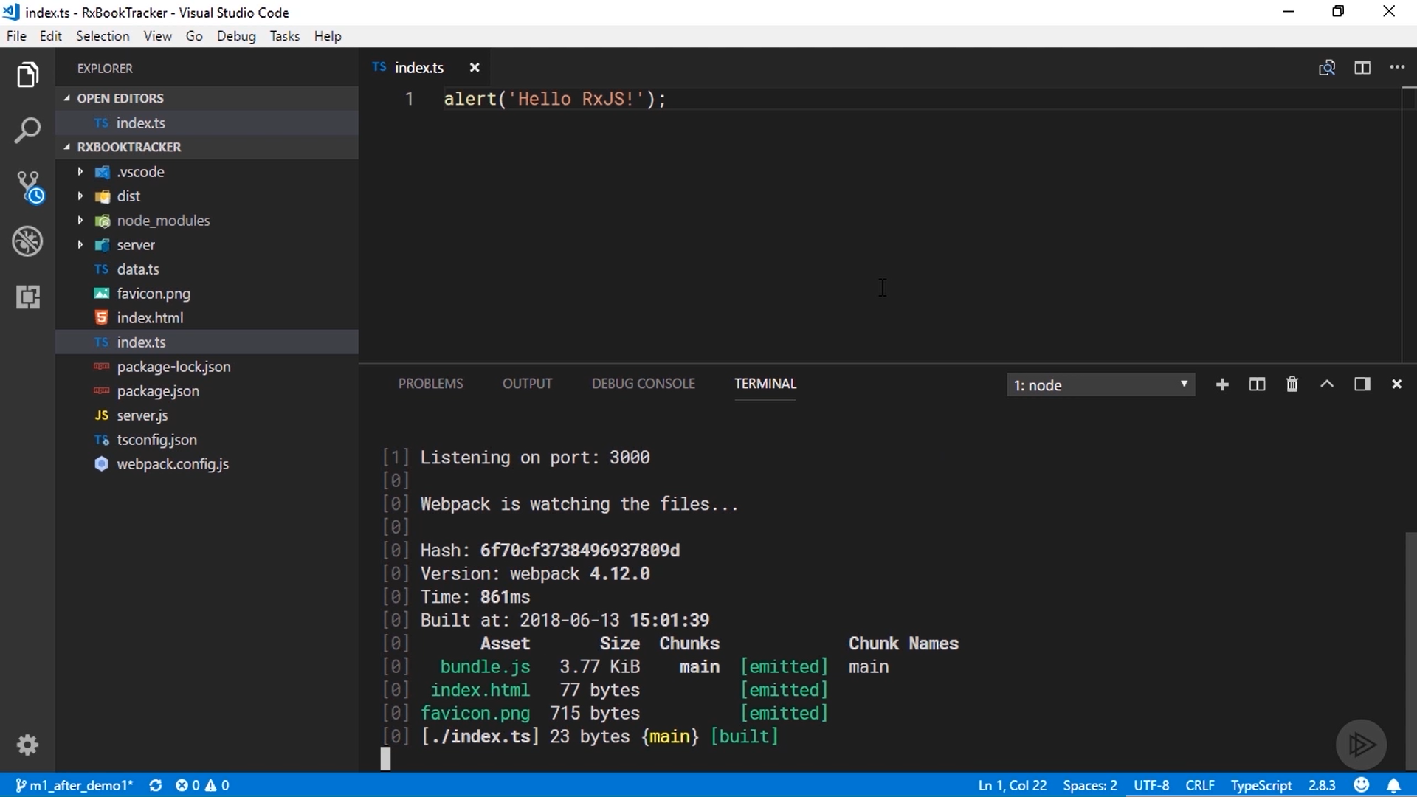

Slide 36
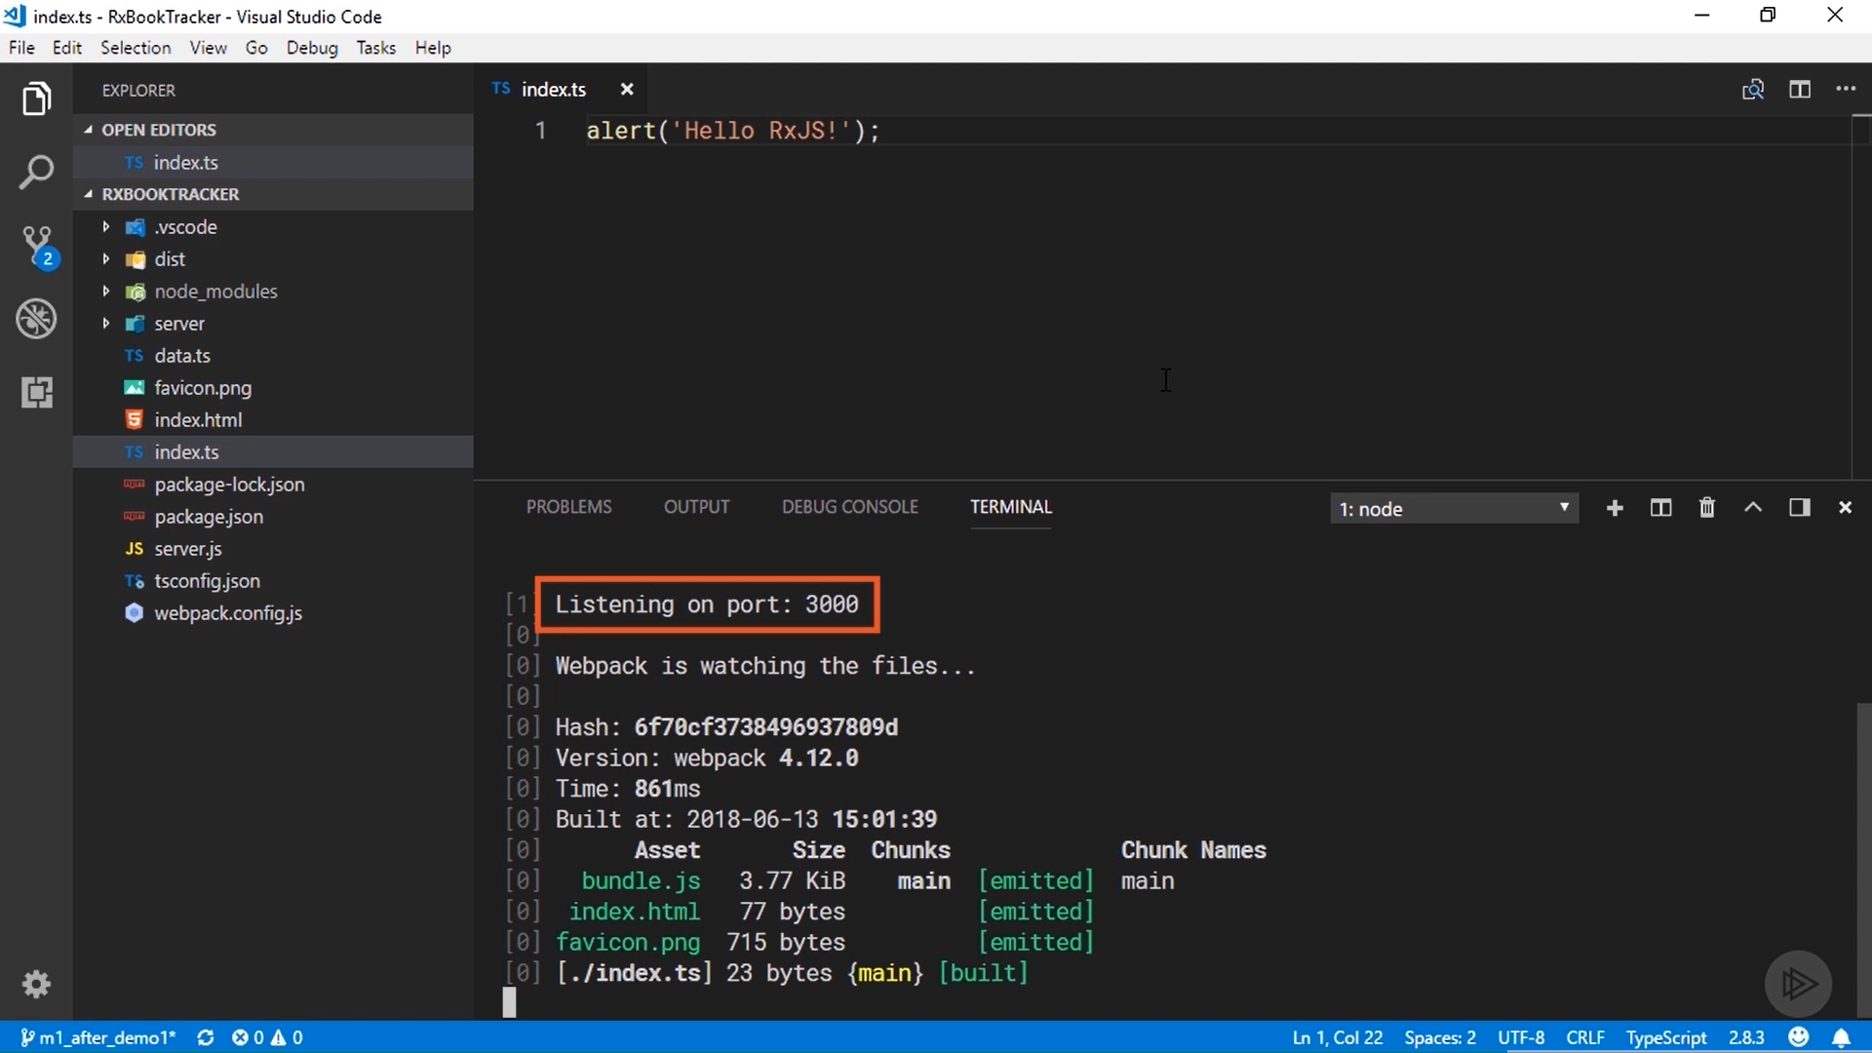

Slide 37
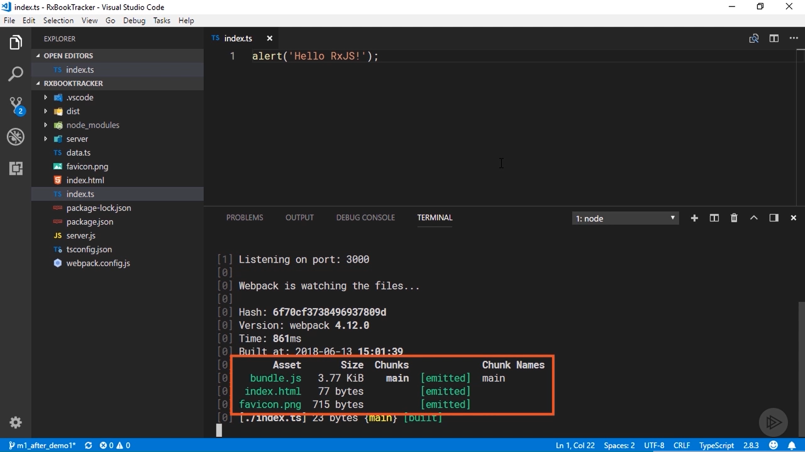

Slide 38
In the browser and open the app with the address localhost:3000.
It immediately shows the alert message .
Because I started Webpack in watch mode, it's still running and will automatically recompile and bundle any new changes I save.
In order to stop it, just type Ctrl+C here in the terminal.
Now we have everything I need to start experimenting with RxJS, except RxJS itself.

Slide 39
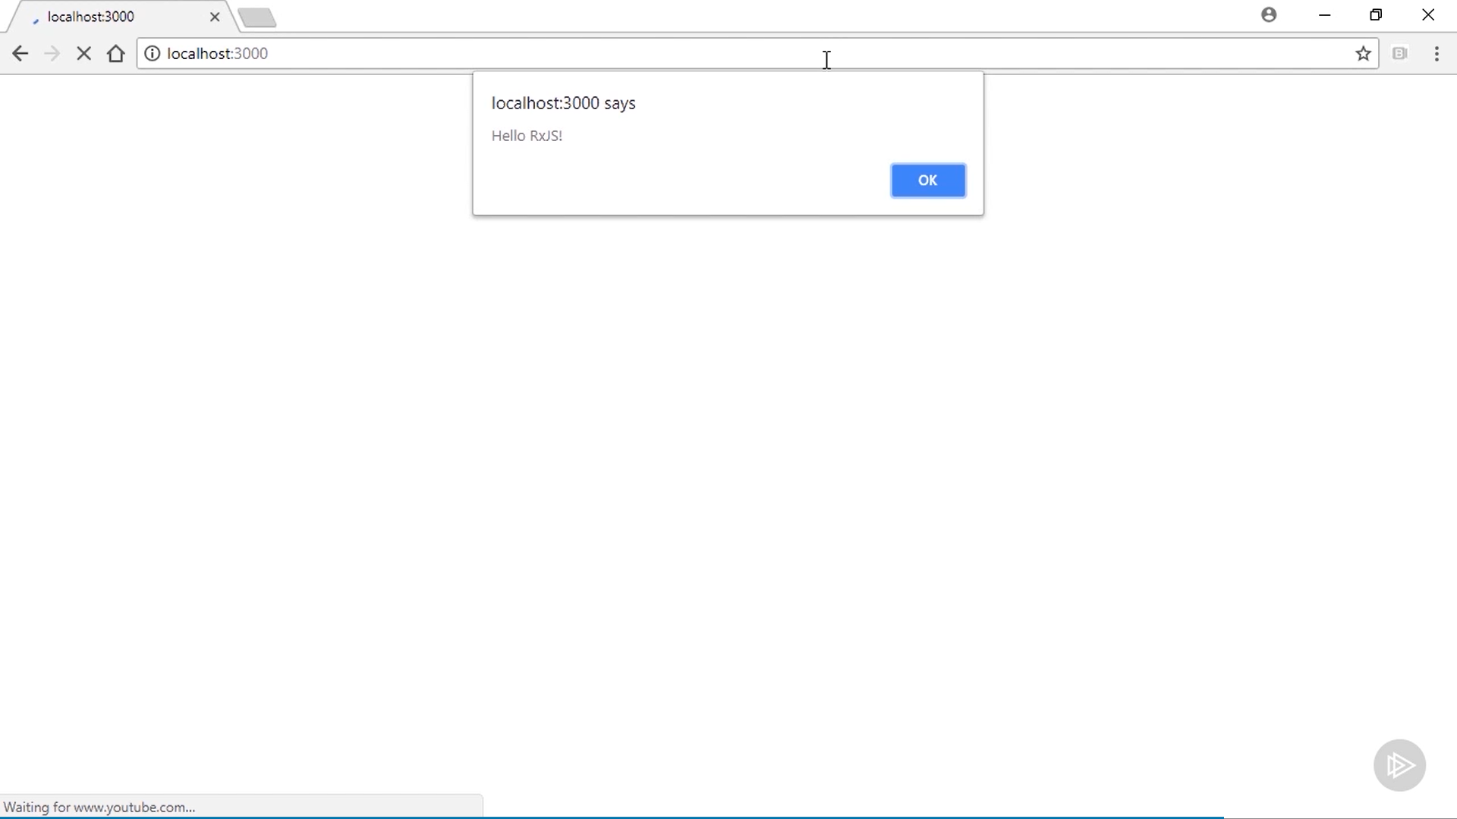

Slide 40
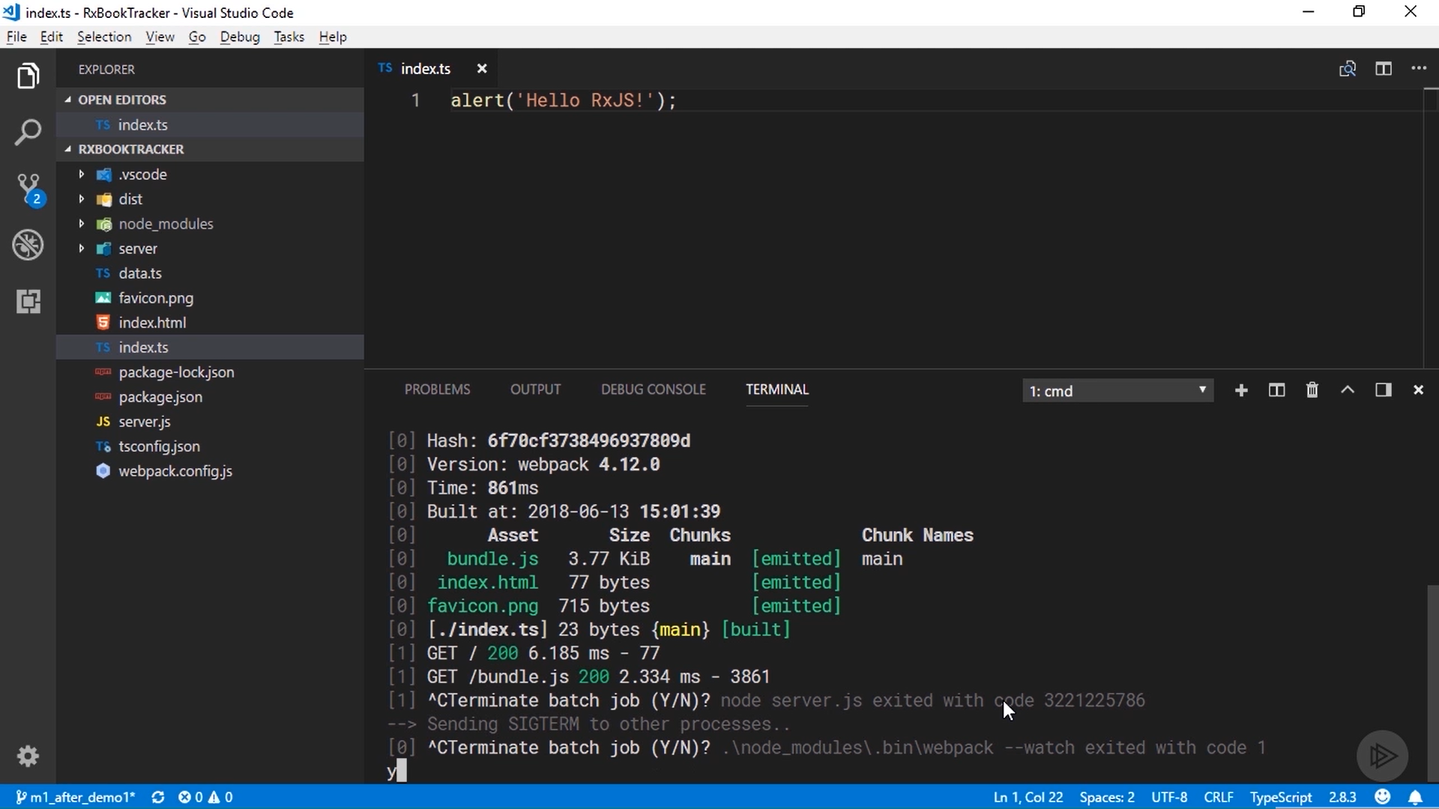

Slide 41
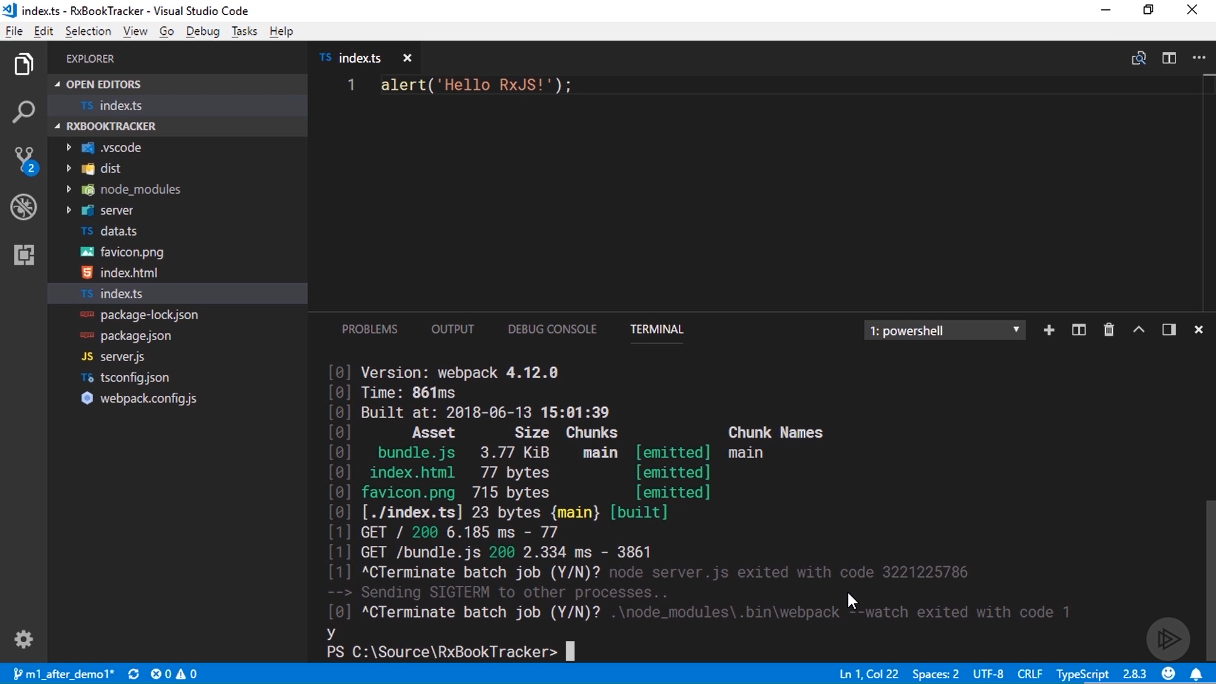

Slide 42
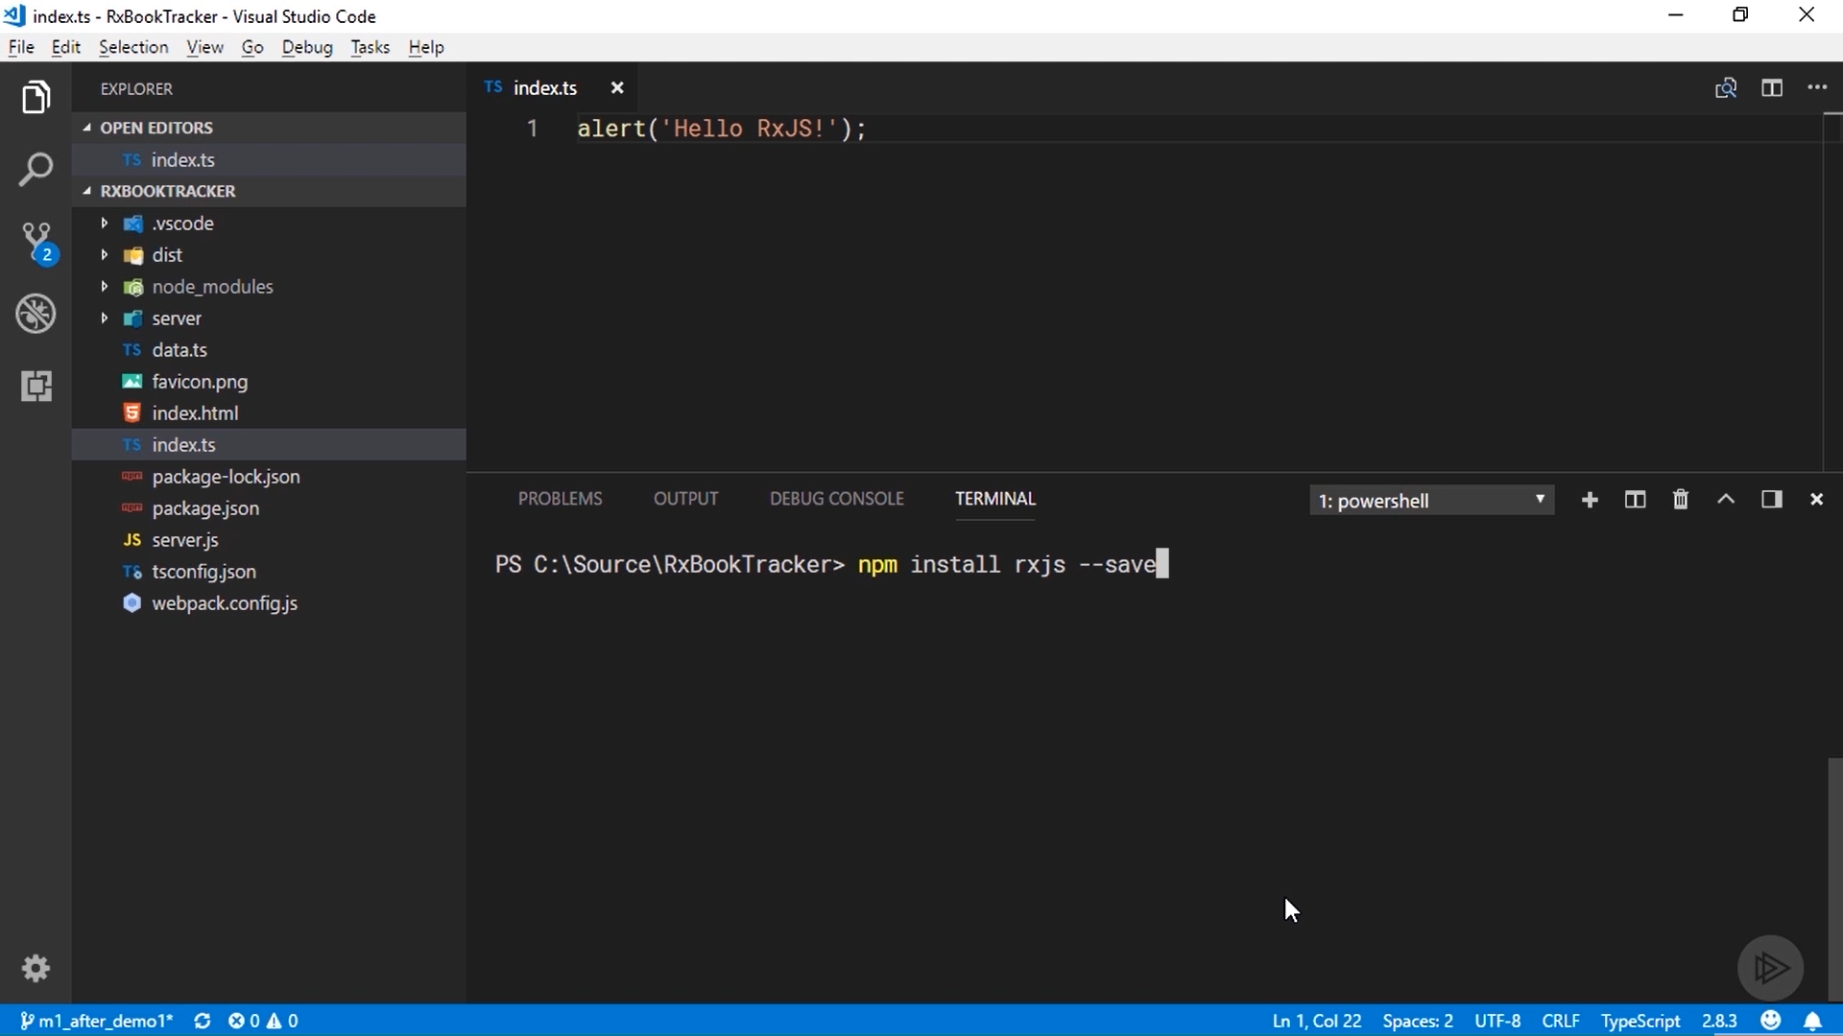

Slide 43
To install RxJS. The command is npm install rxjs --save.
The save option just tells npm to save a reference to the package in the package. json file.
It installed version 6. 2. 1, and open package. json again, and you can see that a new reference was added to the dependencies section for it.

Slide 44
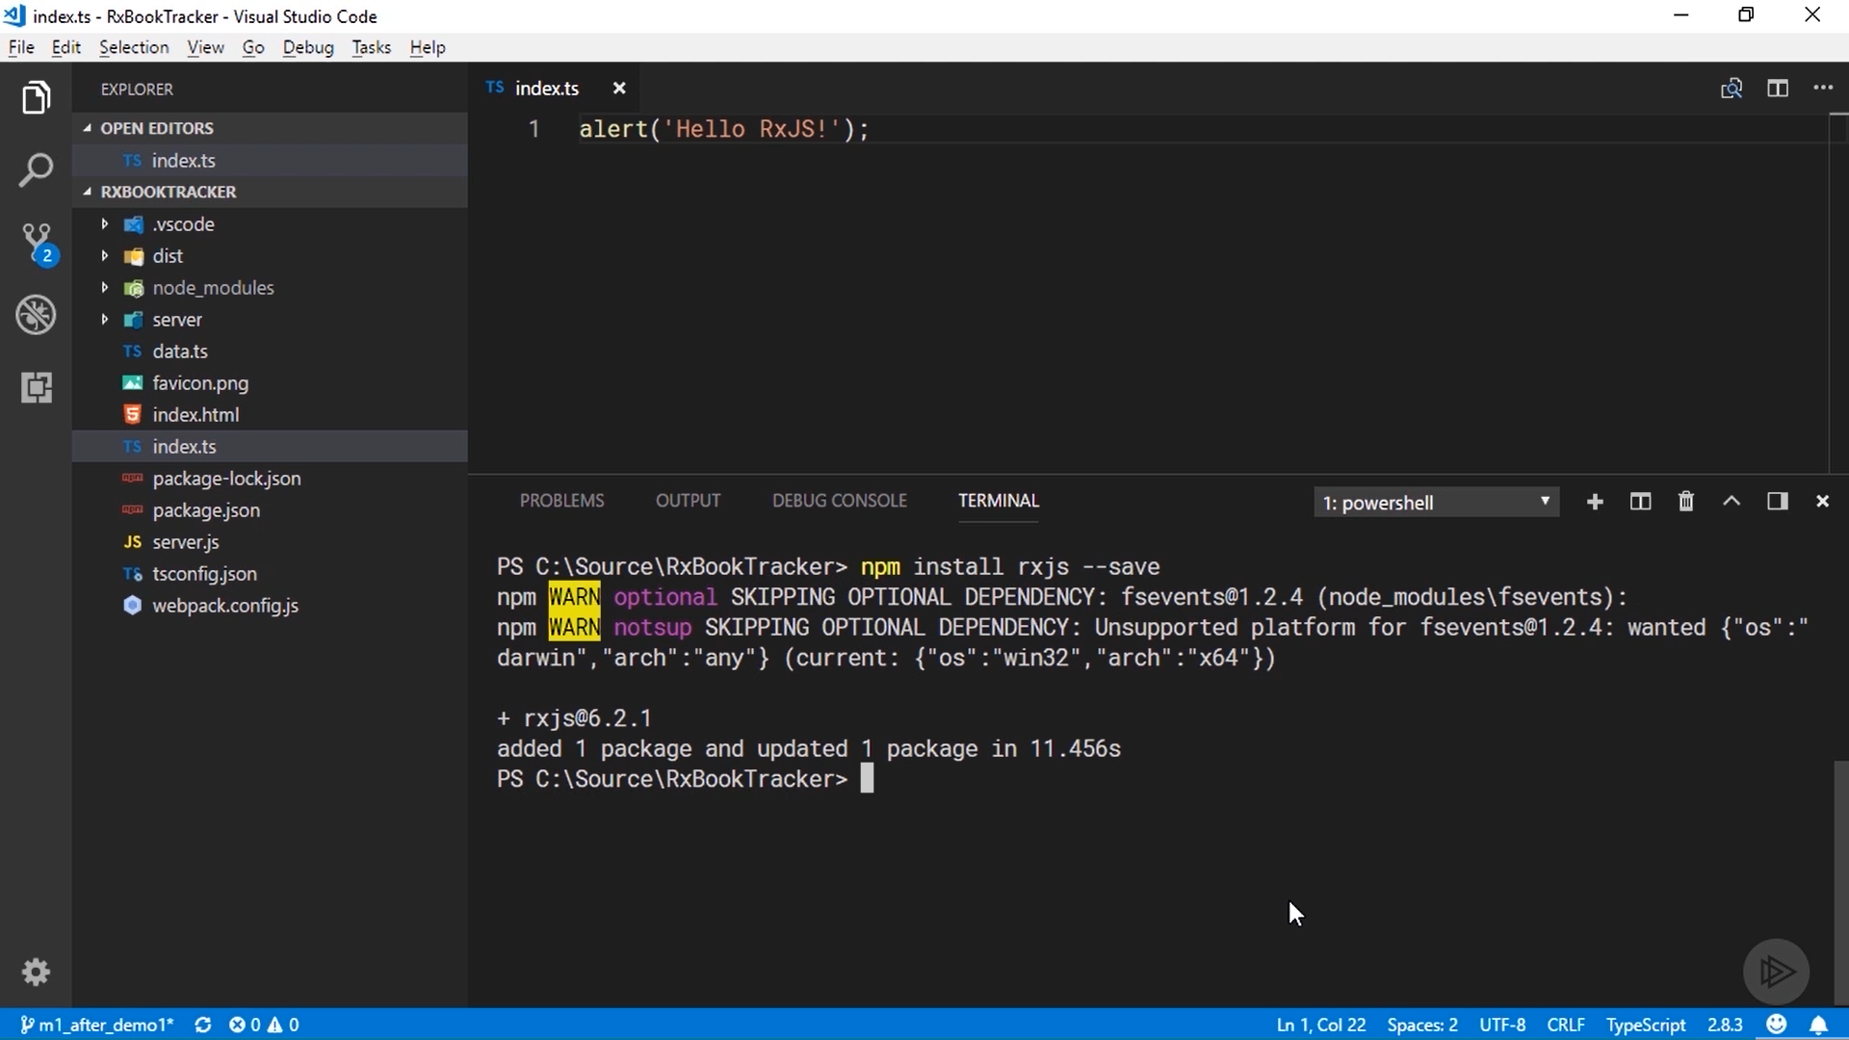

Slide 45
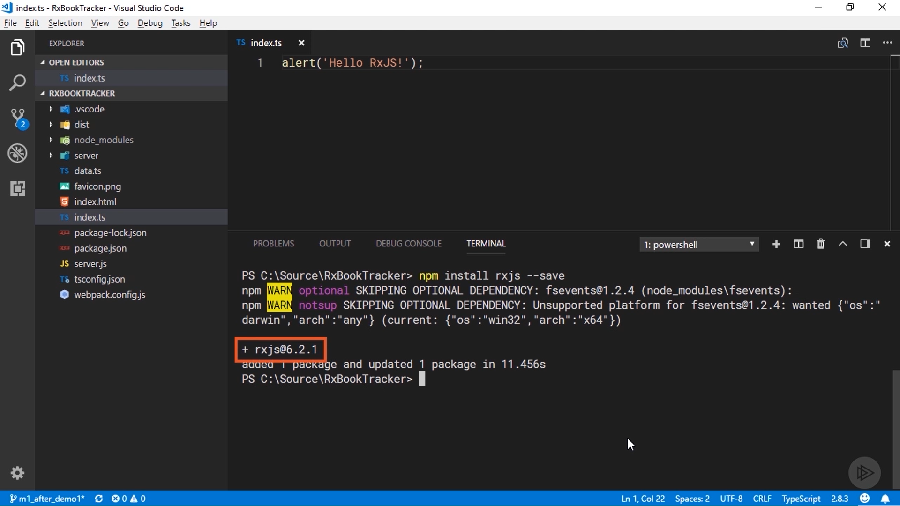

Slide 46
